Slide 1
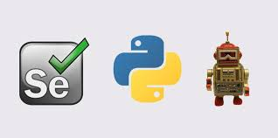
Robot Framework
Keyword Test automation
Sony George

Slide 2
Robot Framework
Robot Framework is a generic test automation framework for acceptance testing and acceptance test-driven development (ATDD).
It has easy-to-use tabular test data syntax and it utilizes the keyword-driven testing approach.
Its testing capabilities can be extended by test libraries implemented either with Python or Java, and users can create new higher-level keywords from existing ones using the same syntax that is used for creating test cases.

Slide 3
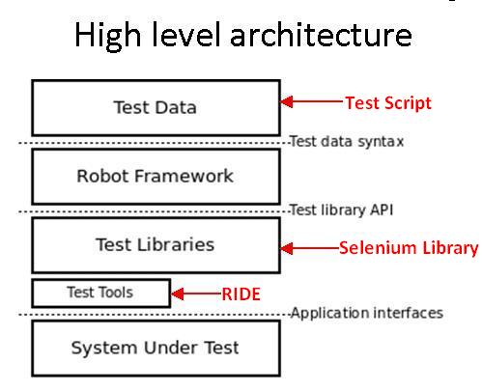
Robot Framework

Slide 4
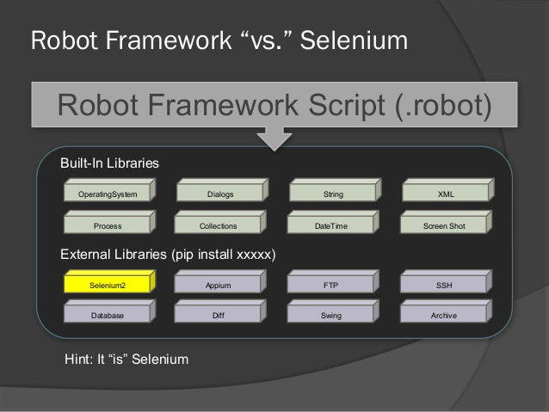
Robot Framework

Slide 5
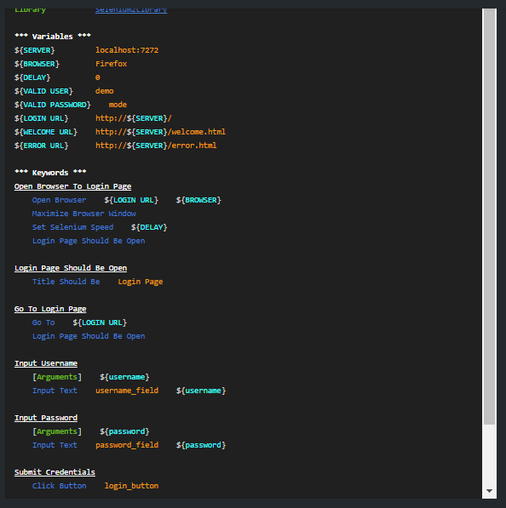
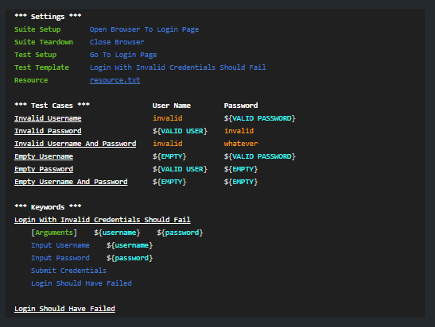
Robot Framework

Slide 6
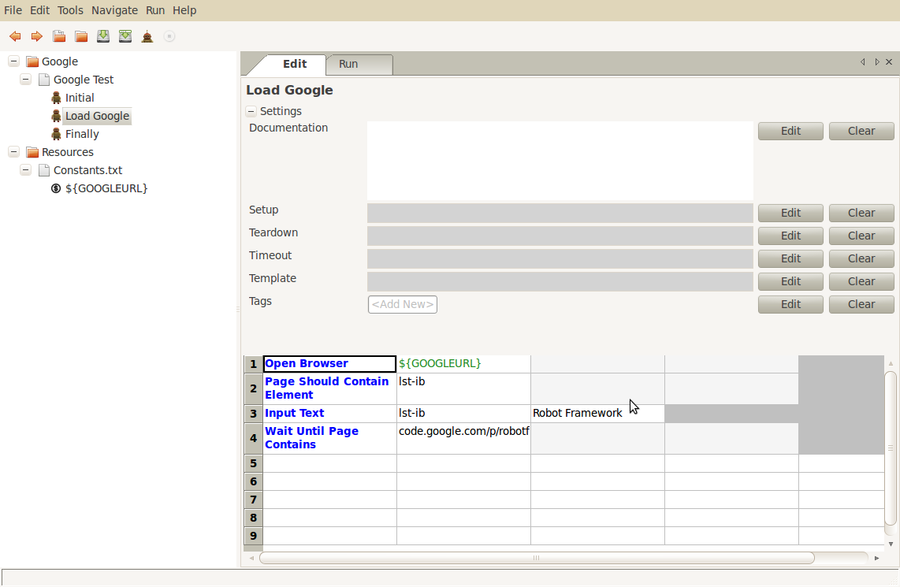
Robot Framework

Slide 7
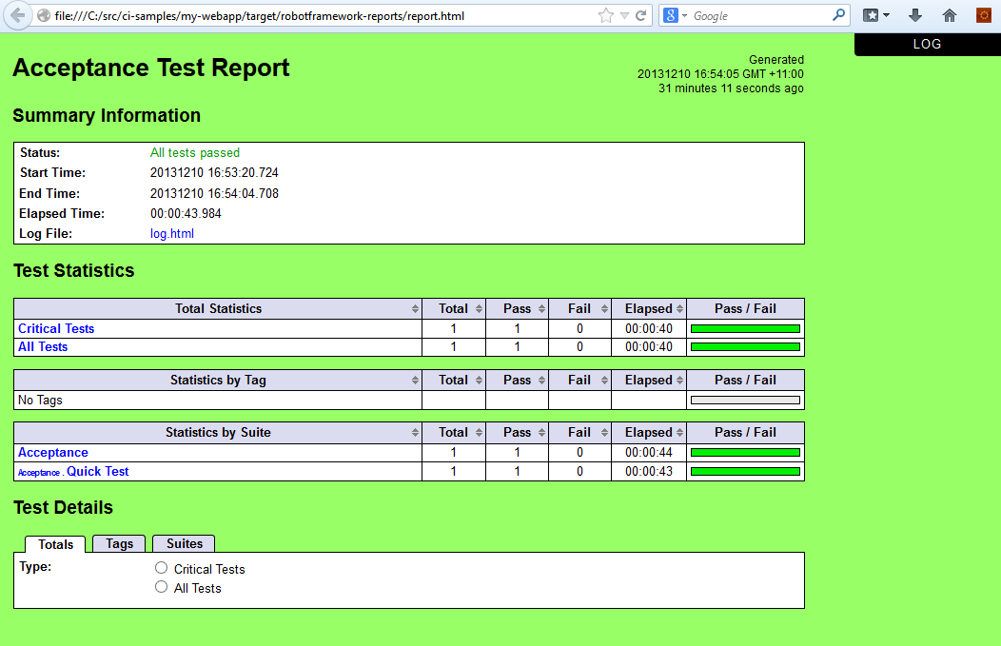
Robot Framework

Slide 8
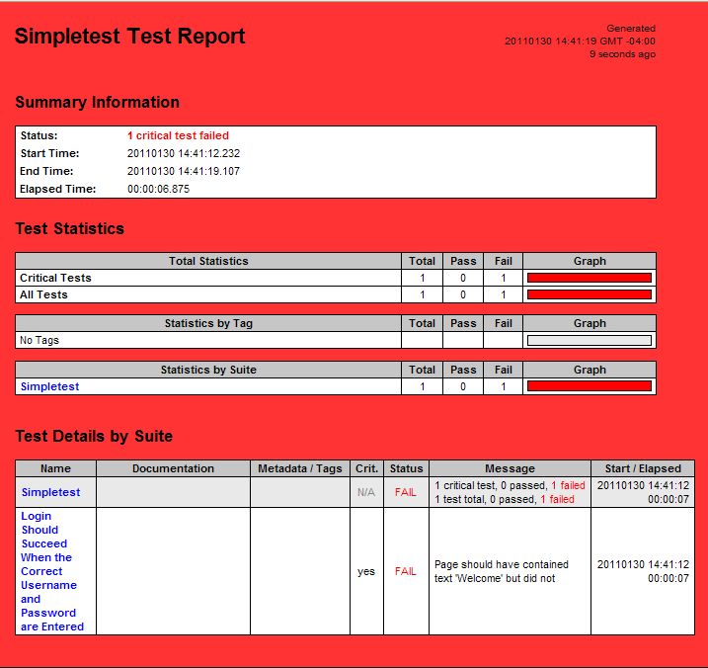
Robot Framework

Slide 9
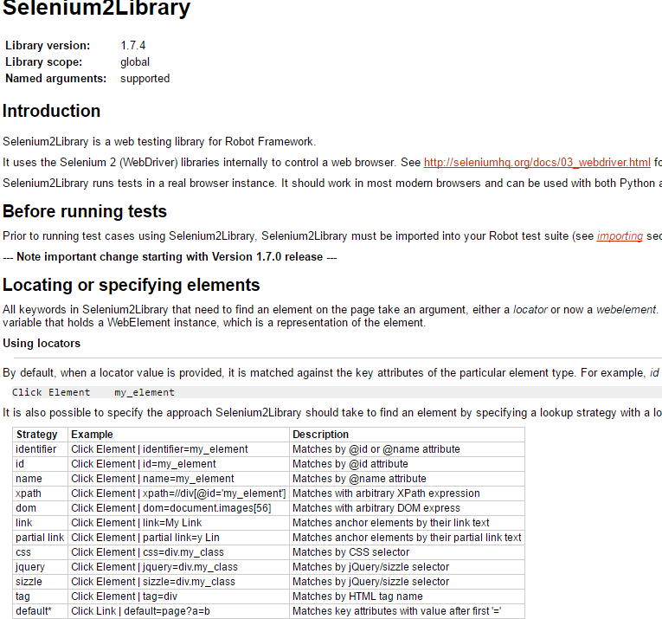
Robot Framework
http://robotframework.org/Selenium2Library/doc/Selenium2Library.html

Slide 10
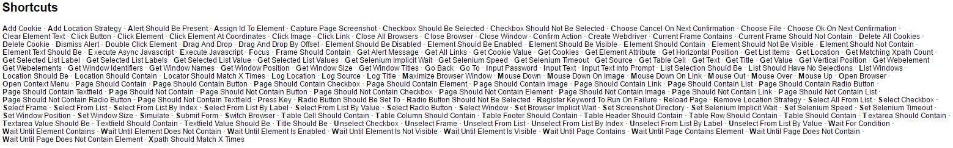
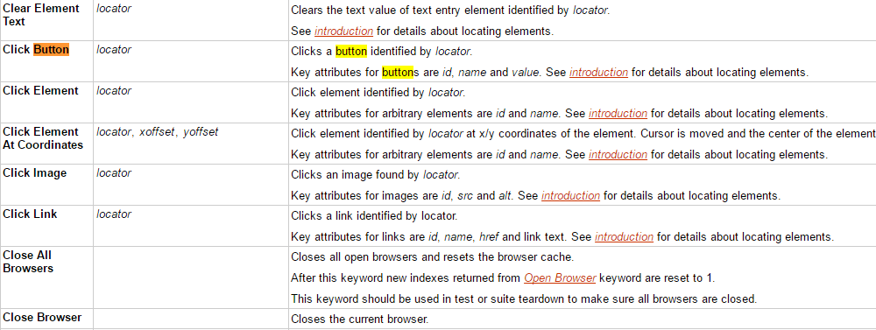
Robot Framework

Slide 11
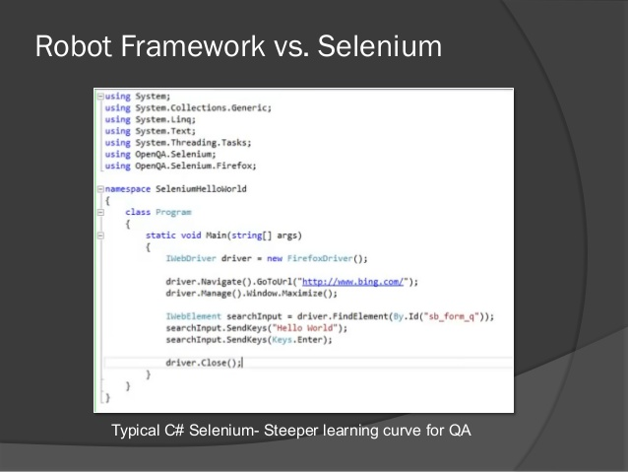
Robot Framework

Slide 12
Robot Framework
How to install?
http://robotframework.org/robotframework/latest/RobotFrameworkUserGuide.html

Slide 13
Thank you everyone ☺

